Slide 1
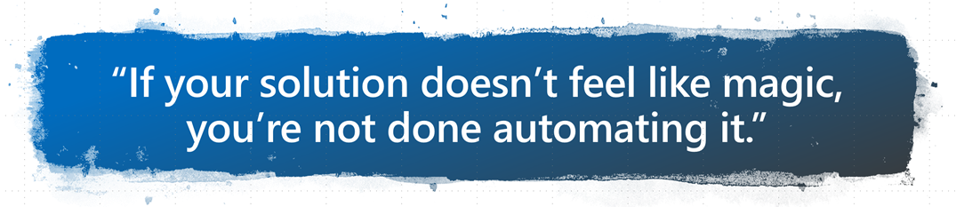

DevOPS for Office 365
Configuration Management for the Cloud
Nik Charlebois – Senior Premier Field Engineer
Aka.ms/SPSOttawa

Slide 2













Thank you Sponsors!!
Platinum
Gold
Silver
Prize(s)

Slide 3
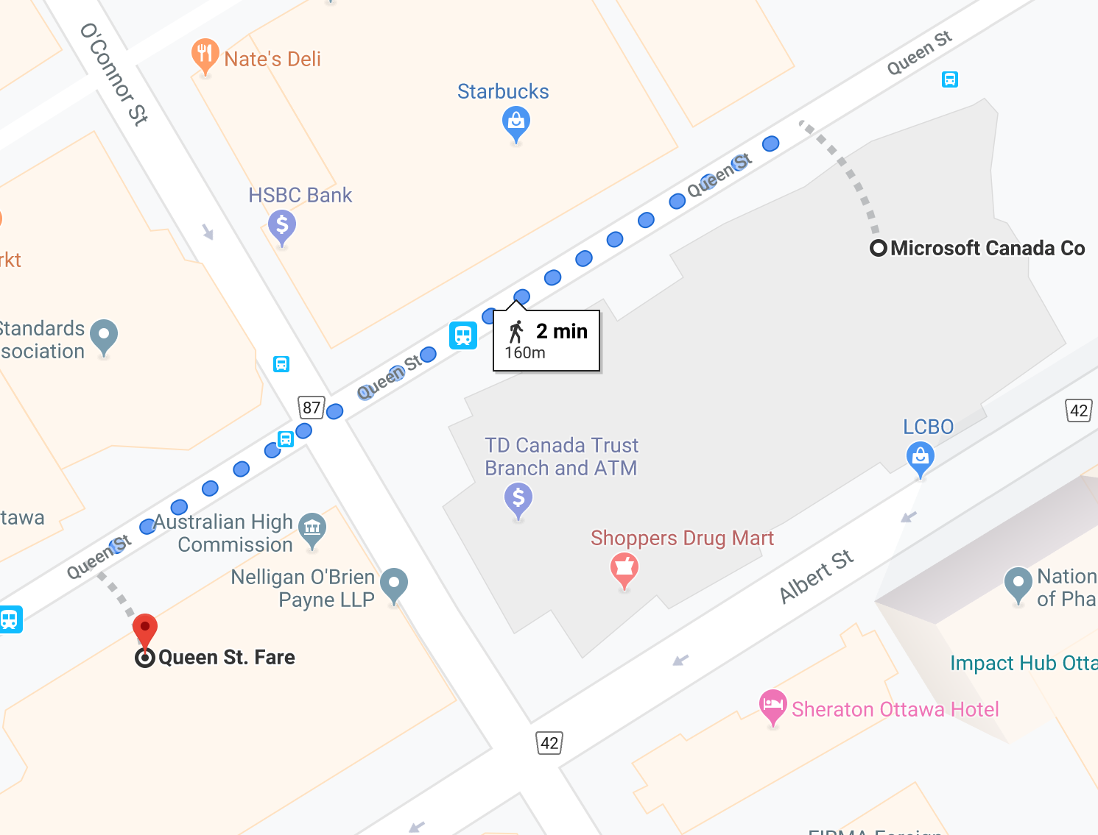

@5:15 pm
Queen Street Fare – 170 Queen Street
(first round on us)
ShareP nt
Please drink responsibly ☺. We will be happy to call a cab for you

Slide 4
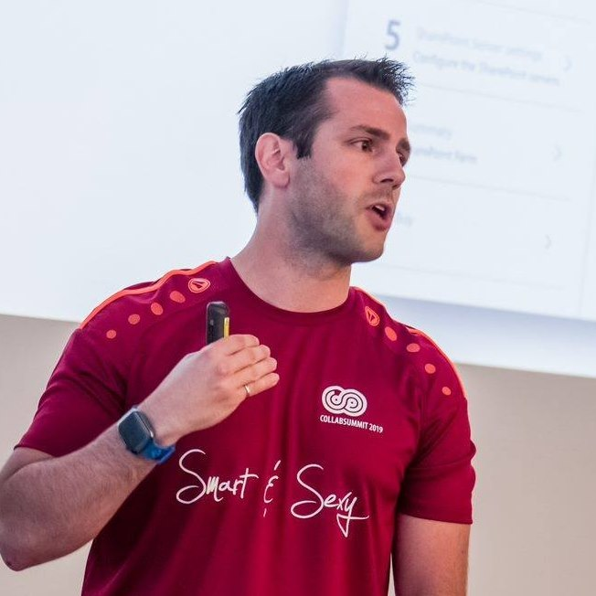
‏@NikCharlebois
Microsoft Senior Premier Field Engineer
Focusing on SharePoint Development and Automation
Overall DSC goodness evangelist
About Me
Ex Public Servant and PowerShell MVP
Author of the books Beginning PowerShell for SharePoint 2013 and 2016 & Office 365 Experts
Based at this Office (Ottawa)
Speaker at various technology conference
Blogger at http://NikCharlebois.com
Co-Owner of SharePointDSC and Owner of ReverseDSC & Office365DSC

Slide 5
Managing Expectations
It is a technical session
We’ll take about 15 minutes to do an introduction to DSC;
Get concrete examples you can apply today in your organization;
Please ask your questions as we go;

Slide 6
Agenda
Overview of PowerShell DSC;
Introduction to Office365DSC;
ReverseDSC in action;
Azure DevOPS & Integration scenarios for Office 365;

Slide 7
Desired State Configuration

Slide 8

PowerShell DSC (10,000 feet overview)
Deployment Automation and monitoring solution;
Ensures that environments stay in their Desired State;
PowerShell 4.0 and above (therefore no support for SP2010);

Slide 9
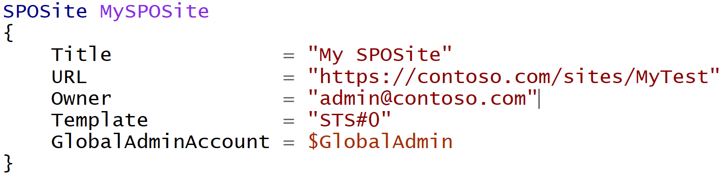
Difference with Classic PowerShell
It’s a Declarative approach;
Notes:
Meaning I don’t tell it do this and then that, but rather here is how I want this, then do whatever in you need to to get me there

Slide 10
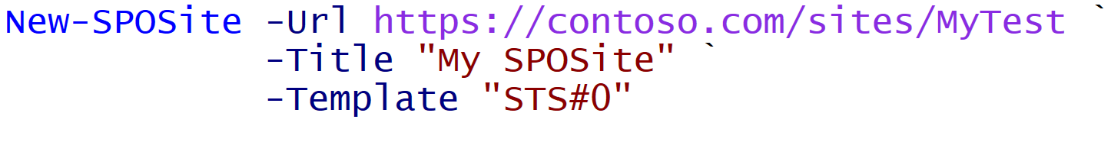
Difference with Classic PowerShell
Declarative:
Imperative
Notes:
Meaning I don’t tell it do this and then that, but rather here is how I want this, then do whatever you need to get me there

Slide 11
Monitor Configuration Drifts
+Fix
+Monitor
Default Setting
ApplyOnly
ApplyAndMonitor
ApplyAndAutocorrect
Configure as specified, the done
Configure, and Log Configuration Drifts
Configure, Log & Fix Configuration Drifts

Slide 12
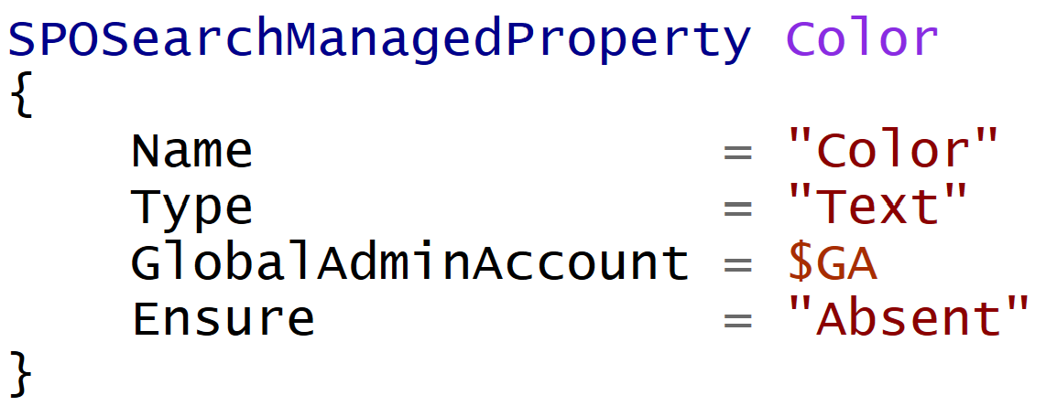
Ensure
DSC is not only about making sure that certain components are configured on a sever;
Most resources have a parameter Ensure exposed;
Setting Ensure = Absent makes sure that the specified component is NEVER configured on the server;
Hard to define all “non-config” scenarios….it’s actually impossible;

Slide 13
Demo 1
Basic DSC

Slide 14
Office365DSC

Slide 15

DSC Modules
Macro components that extend the reach of DSC (e.g. SharePointDSC, SQLServerDSC, etc.)
All available on the PowerShell Gallery (http://PowerShellGallery.com)

Slide 16
What does Office 365 DSC have to offer?
Allows you to manage your O365 tenant(s) configuration “as code”
Configure multiple tenants the same
Export your current tenant configuration (Export-O365Configuration)

Slide 17


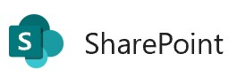





Office365DSC
Brand new DSC module to configure and monitor Office 365 Tenants’ Configuration;
Supports most major workloads;
Support coming for additional Workloads
Security & Compliance
PowerApps
Flow […]

Slide 18

Office365DSC […]
Abstraction layer sitting on top of all underlying modules:
MicrosoftTeams
SharePoint PnP
AzureAD
Security & Compliance + Exchange Online
Etc.
Allows you to write 1 configuration to handle all workloads;

Slide 19
Logic Flow
Office365DSC Configuration
SharePoint PnP
MicrosoftTeams
Exchange Online Shell
…
Remote Calls
Security & Compliance

Slide 20
Office365DSC
Visit wiki for details on current workloads
Aka.ms/Office365DSCWiki

Slide 21
Office365DSC
Help wanted
Testing
Development
Suggestions and ideas
Please visit Github site
Aka.ms/Office365DSC

Slide 22
Demo 2
Office 365 Deployment

Slide 23
ReverseDSC

Slide 24

ReverseDSC
Extract DSC Configuration from existing environments;
Native feature inside of Office365DSC;
Installing Office365DSC exposes Export-O365Configuration;
Offers a RETRO User interface straight out of the 90’s for granular extractions

Slide 25
ReverseDSC Scenarios
Recreating an environment for Troubleshooting;
Point-in-time snapshot;
Delta Analysis;
Disaster Recovery;
On-boarding existing environment onto DSC for monitoring;
Keeping environments in-sync;

Slide 26
Demo 3
ReverseDSC for Office365DSC

Slide 27
Demo 4
Tenants Synchronization

Slide 28
Azure Automation

Slide 29


Dedicated Virtual Machine Agent
Requires a Virtual Machine to be up and running to deploy configuration and do consistency checks;
Config
Dedicated Virtual Machine
Tenant

Slide 30




“Agentless Process” with Pipelines
Changes Applied
Changes Applied
Azure DevOPS Repo
Dev Tenant
QA Tenant
Reviews & Approves
Commits Changes
Reviews & Approves
Master Config
Add/Modify/Delete
Dev Team
QA Team

Slide 31


Pull Server
Central server that stores all configurations for your enterprise (e.g. WFE, SQLServer, DC, etc.)c
Pull Server

Slide 32
Pull Server
Central server that stores all configurations for your enterprise (e.g. WFE, SQLServer, DC, etc.)
Pull Server

Slide 33

Overview of AADSC
Pull Server as a Service;
Included as part of an Azure Automation Account;
Free when used with Azure VMs;

Slide 34



Overview of AADSC[…]
Azure Virtual Machine
DSC Script
Azure Automation

Slide 35




Process – With Dedicated VM Agent
Triggers
Compiles
Uploads
Azure DevOPS Repo
Assigns
Commits Changes
Deploys
Master Config
Virtual Machine Agent
Office 365 Tenant

Slide 36
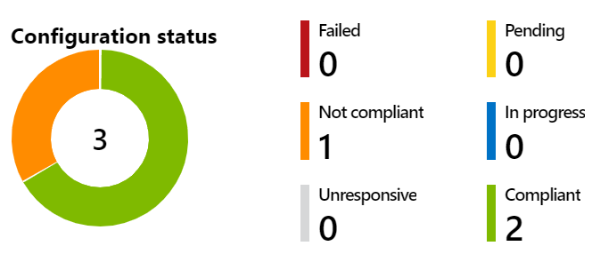
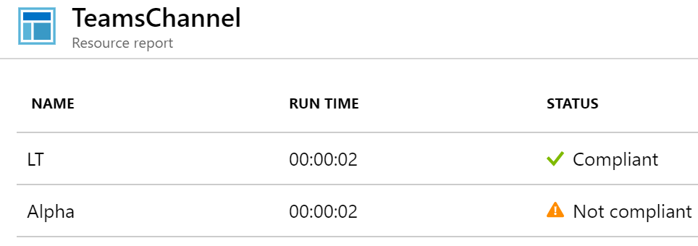
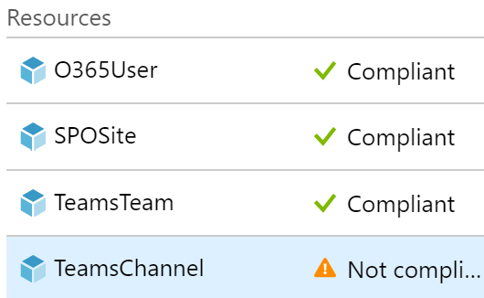
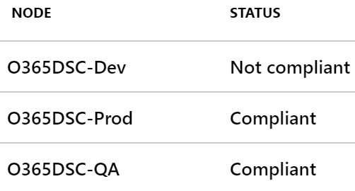
Azure Automation
Centrally manage configuration for all your tenants;
Get rich insights into potential configuration drifts;

Slide 37
Azure DevOPS

Slide 38

Azure DevOPS
Manage your Office 365 configuration as code;
Automate deployments upon configuration changes;
DevOPS at its best!
Challenge is to convince IT Pros to use it.

Slide 39


Process
Compliant
Test-DSCConfiguration
Dev Tenant
Test-DSCConfiguration
Not Compliant
[SPOSite]abc
not compliant
QA Tenant
Test-DSCConfiguration
Compliant
Prod Tenant

Slide 40
Demo 6
Azure DevOPS for Office 365

Slide 41
Questions

